Slide 1

Data Protection and PII data presented by: Shubham Kumar Sharma Yash Raj
Notes:
Personal Identifying Information (PII) data is any piece of information that can be used to identify a specific individual. This data is sensitive and needs to be protected to prevent identity theft, financial fraud, and other malicious activities. As a software developer, it is important to understand how to handle PII data securely to avoid data breaches and protect user privacy.

Slide 2

PII Data Overview
PII data includes personally identifiable details such as name, address, phone number, email address, Social Security number, passport number, driver's license number, date of birth, and biometric data.
PII data can be found in various systems and applications, including customer relationship management (CRM) databases, employee records, and e-commerce platforms.
Data protection regulations such as GDPR, CCPA, and HIPAA define strict guidelines for handling PII data.
PII data can be classified into two categories: sensitive PII and non-sensitive PII, and each requires different protection measures.
Notes:
The term 'personal information' refers to any data that can identify a specific individual. PII data can include sensitive information such as financial records, medical records, and criminal records, as well as non-sensitive information such as employment history, education, and contact information. In order to protect PII data, it is important to understand where it is stored, how it is used, and how it is shared.

Slide 3
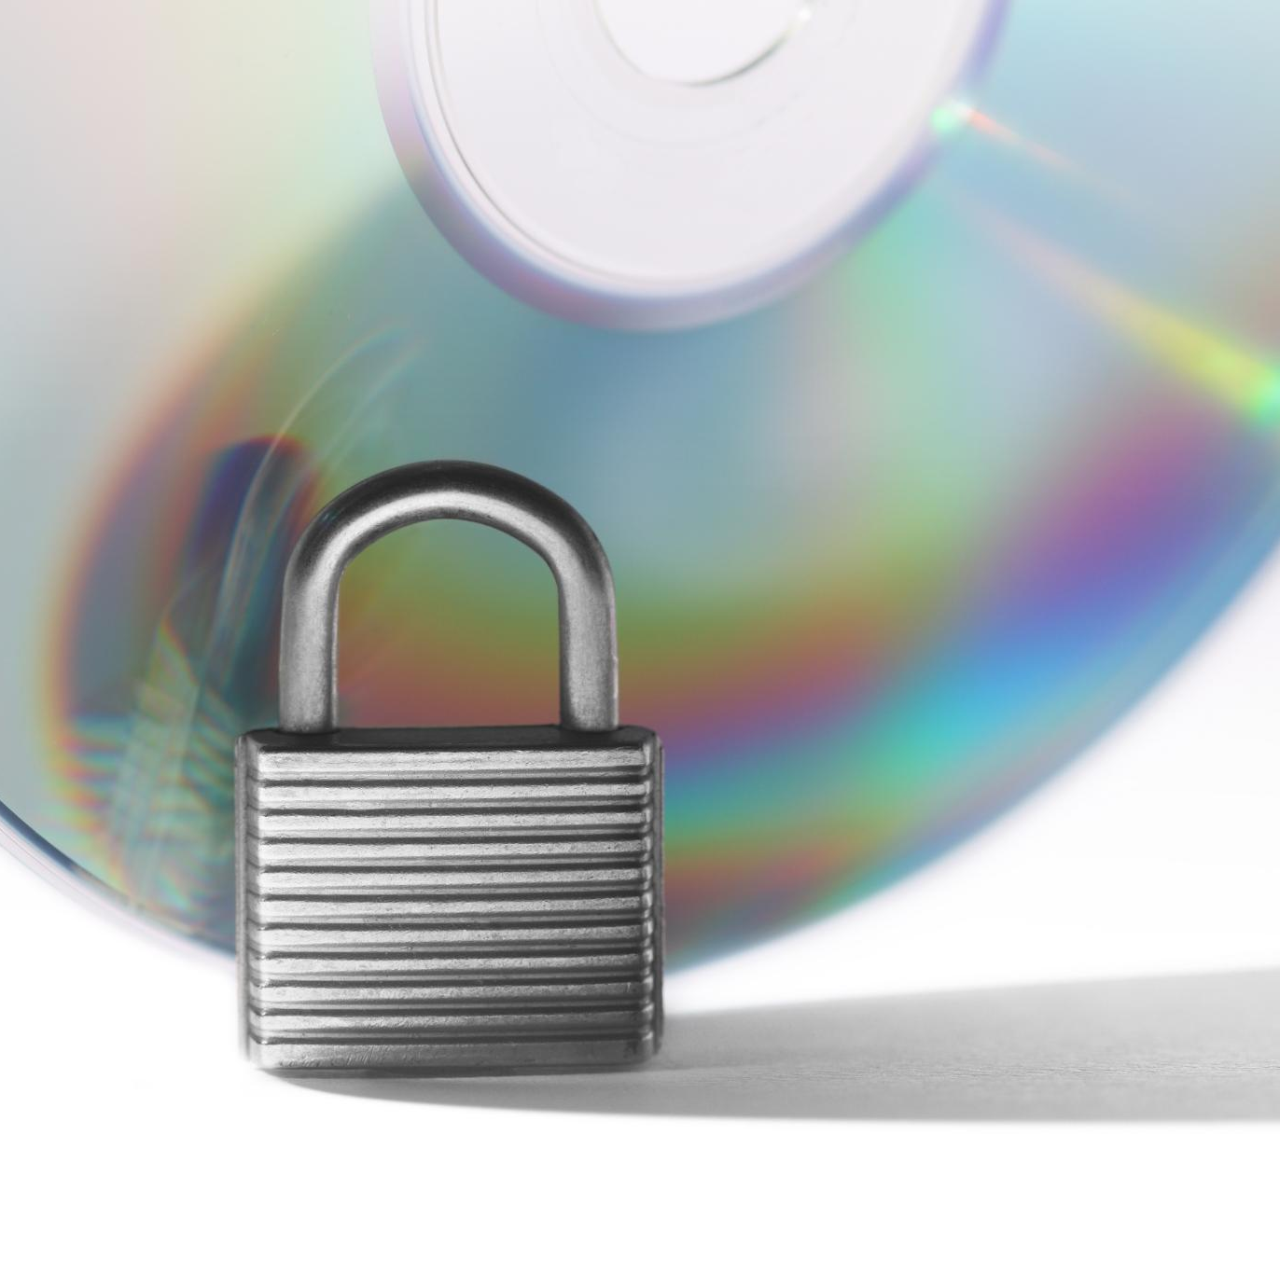
PII Data Handling Laws in Different Countries
Several countries have laws for handling PII data
European Union has General Data Protection Regulation (GDPR)
In the United States, different states have different laws
India has Personal Data Protection Bill (PDPB)
Singapore has Personal Data Protection Act (PDPA)
Australia has Privacy Act
Notes:
Personal Identifiable Information (PII) data is sensitive information that uniquely identifies an individual, like name, address, etc. Many countries have laws to protect this information. In the European Union, the General Data Protection Regulation (GDPR) sets out rules for how PII data can be collected, used, and stored. In the United States, laws for handling PII data vary from state to state. India has recently introduced the Personal Data Protection Bill (PDPB) and Singapore has the Personal Data Protection Act (PDPA). Australia has the Privacy Act which regulates how entities handle personal information.

Slide 4

Overview of GDPR
GDPR is a regulation in EU law on data protection and privacy
It came into effect on May 25, 2018
It applies to all companies processing the personal data of data subjects residing in the EU, regardless of the company’s location
GDPR gives individuals greater control over their personal data and the right to access, modify or delete their data
Fines for non-compliance can be up to €20 million or 4% of global annual revenue, whichever is higher
Notes:
This slide provides an overview of GDPR, which is a regulation in EU law on data protection and privacy. The regulation came into effect on May 25, 2018, and applies to all companies processing the personal data of data subjects residing in the EU, regardless of the company's location. GDPR gives individuals greater control over their personal data and the right to access, modify or delete their data. Non-compliance can result in significant fines.

Slide 5

Handling PII Data as a Software Developer
As a software developer, it is important to understand your role in protecting PII data.
Developers should use secure coding practices and encryption algorithms to protect PII data in transit and at rest.
Developers should also implement access control mechanisms and audit trails to monitor and limit access to PII data.
Developers should test their code and systems for vulnerabilities regularly and address any security issues promptly.
Developers should also be aware of data protection regulations and ensure compliance with them.
Notes:
Software developers play a critical role in protecting PII data by building secure systems and applications. Developers should be trained on secure coding practices and encryption algorithms to ensure that PII data is protected in transit and at rest. Access control mechanisms and audit trails should be implemented to monitor and limit access to PII data. Developers should also be aware of data protection regulations such as GDPR, CCPA, and HIPAA, and ensure compliance with them.

Slide 6

Presidio: Data Protection and De-identification SDK by Microsoft
This is an open-source library which provides fast identification and anonymization modules for private entities in text and images. Entities like credit card numbers, names, locations, social security numbers, bitcoin wallets, US phone numbers, financial data and more.
It provides extensibility and customizability to a specific business need.
Facilitate both fully automated and semi-automated PII de-identification flows on multiple platforms.
It provides predefined or custom PII recognizers leveraging Named Entity Recognition, regular expressions, rule-based logic and checksum with relevant context in multiple languages.

Slide 7
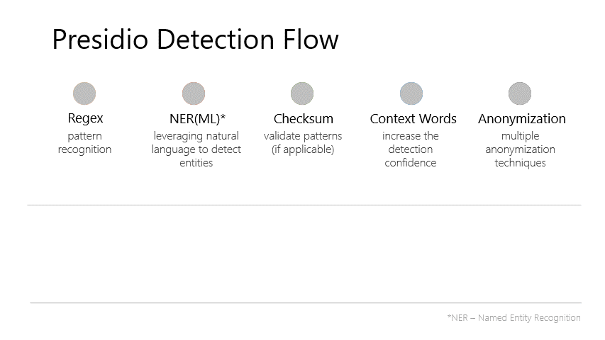
How it works

Slide 8
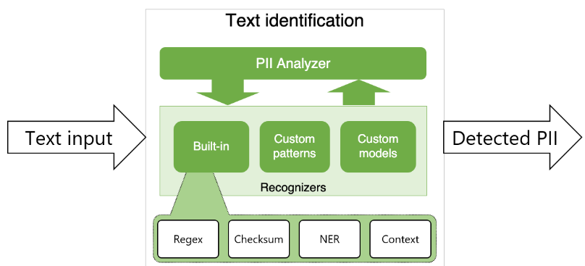
Presidio Analyzer
The Presidio analyzer is a Python based service for detecting PII entities in text.
During analysis, it runs a set of different PII Recognizers, each one in charge of detecting one or more PII entities using different mechanisms.
Presidio analyzer comes with a set of predefined recognizers but can easily be extended with other types of custom recognizers. Predefined and custom recognizers leverage regex, Named Entity Recognition and other types of logic to detect PII in unstructured text.
Supported Entities (Ctrl + Click)

Slide 9
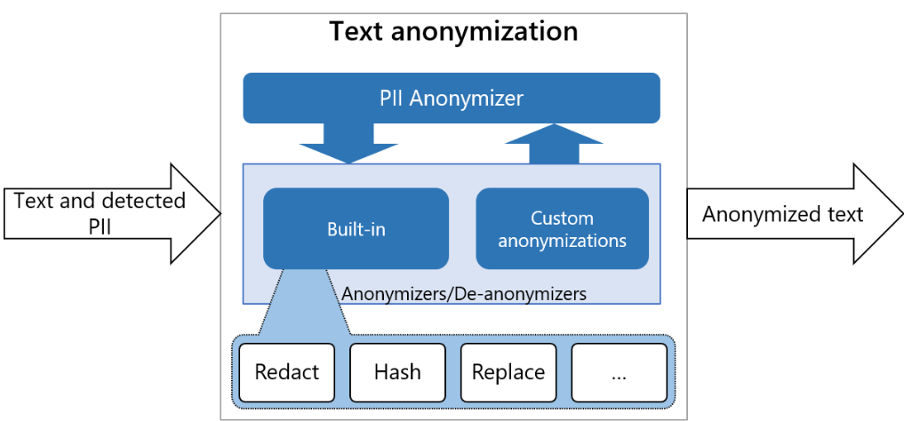
Presidio Anonymizer
The Presidio anonymizer is a Python based module for anonymizing detected PII text entities with desired values. Presidio anonymizer supports both anonymization and deanonymization by applying different operators. Operators are built-in text manipulation classes which can be easily extended.
The Presidio-Anonymizer package contains both Anonymizers and De-anonymizers:
Anonymizers are used to replace a PII entity text with some other value by applying a certain operator (e.g. replace, mask, redact, encrypt)
De-anonymizers are used to revert the anonymization operation. (e.g. to decrypt an encrypted text).
Built-in Operators (Ctrl + Click)

Slide 10
Demos
Demo 1: Presidio Library Functionalities demo (Ctrl + Click)
Demo 2: CSV Data Anonymization Apps

Slide 11
Thank You

